Slide 1

Overcoming Issues of 3D Software Visualization through Immersive Augmented Reality
Alice Truong
Sarah Zurmühle

Slide 2
Table of Content
Introduction
Usability Issues with 3D visualizations
Importance of Paper
Research Questions
Hypothesis
Procedures
Good Parts
Limitations
Findings
Discussion

Slide 3
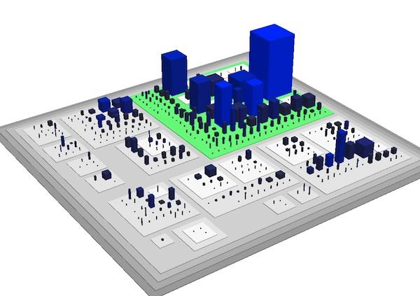
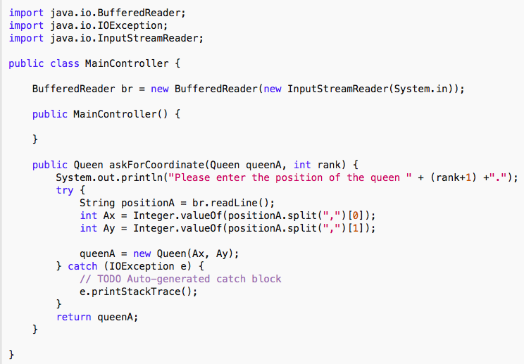
Software Visualization
Software is no physical object → You cannot touch it
3D Visualization provides a way to represent software
Structure
Components
Jim Barritt (2015)
Notes:
Sarah

Slide 4
Introduction
What do you think about this 3D visualization? Are you able to see all components?
Jim Barritt (2015)
Notes:
3D space-time cube technique
Standart Computer Screen

Slide 5
Usability Issues with 3D visualizations
Navigation
Selection
Occlusion
Text Readability
Notes:
Usability issues → Standart Computer Screen, general for 3D visualizations
Navigation: inside the visualization, change angles, ect. with keyboard and mouse
Selection: selecting an item which is e.g. very small
Occlusion: elements blocking the view of other elements
Text Readability: reading 3D text can be very hard

Slide 6
Usability Issues with 3D visualizations
Navigation
Selection
Occlusion
Text Readability
Notes:
Usability issues → Standart Computer Screen
Navigation: inside the visualization, change angles, ect. with keyboard and mouse
Selection: selecting an item which is e.g. very small
Occlusion: elements blocking the view of other elements
Text Readability: reading 3D text can be very hard

Slide 7
Usability Issues with 3D visualizations
Navigation
Selection
Occlusion
Text Readability
Notes:
Usability issues → Standart Computer Screen
Navigation: inside the visualization, change angles, ect. with keyboard and mouse
Selection: selecting an item which is e.g. very small
Occlusion: elements blocking the view of other elements
Text Readability: reading 3D text can be very hard

Slide 8
Usability Issues with 3D visualizations
Navigation
Selection
Occlusion
Text Readability
Notes:
Usability issues → Standart Computer Screen
Navigation: inside the visualization, change angles, ect. with keyboard and mouse
Selection: selecting an item which is e.g. very small
Occlusion: elements blocking the view of other elements
Text Readability: reading 3D text can be very hard

Slide 9
Usability Issues with 3D visualizations
Navigation
Selection
Occlusion
Text Readability
Notes:
Usability issues → Standart Computer Screen
Navigation: inside the visualization, change angles, ect. with keyboard and mouse
Selection: selecting an item which is e.g. very small
Occlusion: elements blocking the view of other elements
Text Readability: reading 3D text can be very hard

Slide 10
Why is this Paper important?
Usability issues influence developer’s
Effectiveness
Experience
No previous research on overcoming usability issues
Notes:
Usability Issues exist generally for 3D visualizations → important
If Immersive Augmented Reality proves to help
effectiveness
decrease usability issues
then the usage of 3D visualization could be improved
Change from 2D Display to 3D immersive augmented reality.

Slide 11
Why is this Paper important?
Improvement of Comprehension Tasks of Developers
Notes:
→ help developers to make better code comprehension tasks
→ Better code quality
→

Slide 12
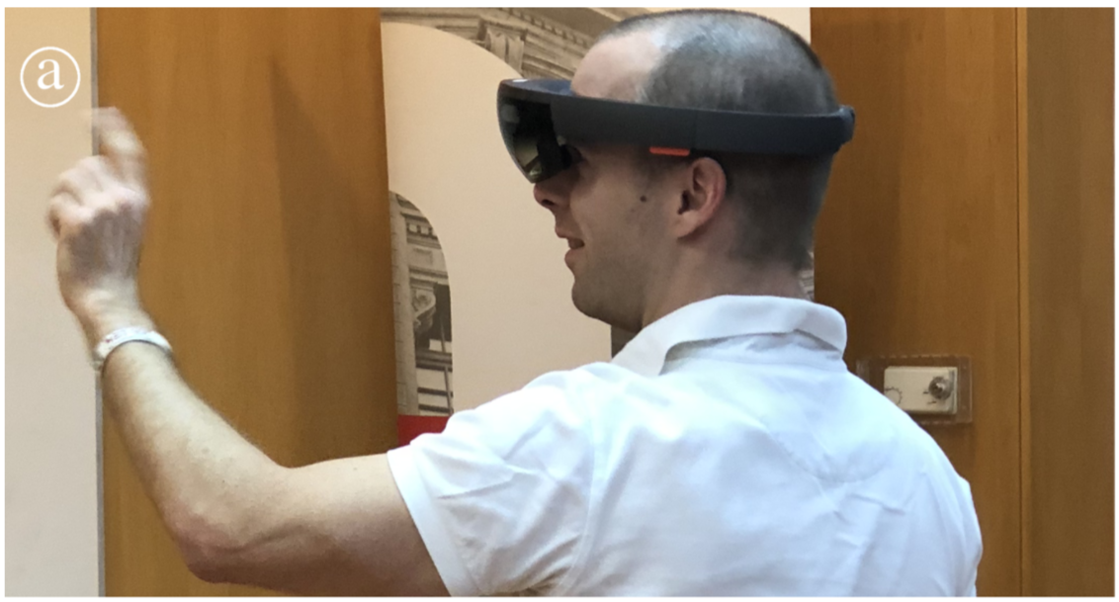
Research Question
Can Immersive Augmented Reality help to
RQ.1 Overcome Usability Issues of general 3D Visualizations?
RQ.2 Increase Developers Effectiveness?
RQ.1.1 Navigation
RQ.1.2 Selection
RQ.1.3 Occlusion
RQ.1.4 Text Readability
Merino et al. (2018, p. 1)
Notes:
HoloLens
RQ1: How can immersive augmented reality help to minimize usability issues of 3D software visualizations?
RQ.1.1) How well is navigation supported in var-
ious 3D software visualization techniques
displayed in immersive augmented reality?
RQ.2.2) How well is selection supported in various 3D software visualization techniques dis-
played in immersive augmented reality?
RQ.3.3) How does occlusion affect developers who use various 3D software visualization techniques displayed in immersive augmented
reality?
RQ.4.4) How does text readability affect developers who use various 3D software visualization techniques displayed in immersive augmented reality?

Slide 13
Hypothesis about Usability Issues (RQ.1)
Displaying Comprehension Tasks in Immersive Augmented Reality can help to overcome usability issues of 3D visualization.

Slide 14






Hypothesis about Effectiveness (RQ.2)
Time
Correctness
Difficulty
Recollection
Emotions
Notes:
3D software visualizations displayed in immersive augmented reality increase software developers effectiveness to support software concerns.
The effectiveness was measured with:
Time
Correctness
Perceived Difficulty
Recollection
Emotions

Slide 15
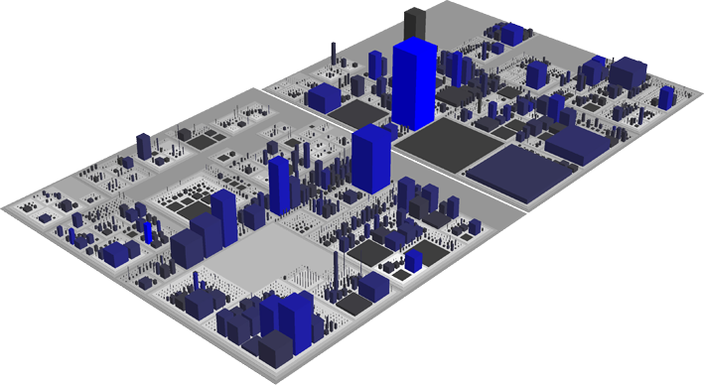
3D City Visualization
Classes
Packages
Richard Wettel (2017)
Notes:
Widely used visualization type and effective for software comprehension tasks
Software data is visualized based on a city metaphor
Buildings represent the classes and the districts of the city the packages
Number of attributes for the classes are mapped on width and length
Number of methods on the height

Slide 16
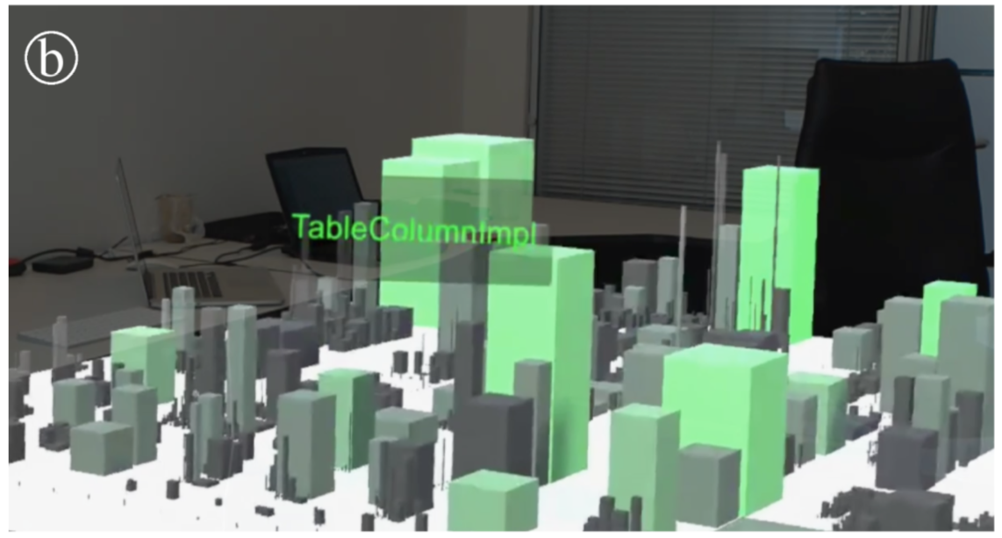
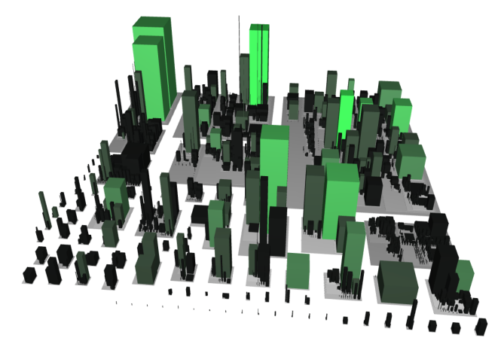



How did they proceed? Increase Developers Effectiveness?
Controlled experiment
Immersive augmented reality
Computer screen
Training Session
Training Session
9 Participants
Same comprehension tasks
9 Participants
User performance
Completion time
Correctness
Recollection → Drawing
User experience
Difficulty → Likert scale
Emotion → Cards
Notes:
Compared 3D visualizations in Immersive augmented reality to the baseline Computer screen
3D city visualization in both conditions
AR condition they had to navigate by walking and approaching building and select by focusing a building with their eyes
Computer screen navigation and selection with the mouse
Between group design
9 - Bern, Konstanz, avg age 27, avg experience 7.5 years
9 - Chile, avg 28, avg experience 9 years
Trained with data set from small software system Axion
Comprehension tasks from large software system Azureus BitTorrent client
Two types of tasks: Finding outliers and identifying patterns
Collected data: User performance, user experience
Half class limitations, and half class good parts

Slide 17

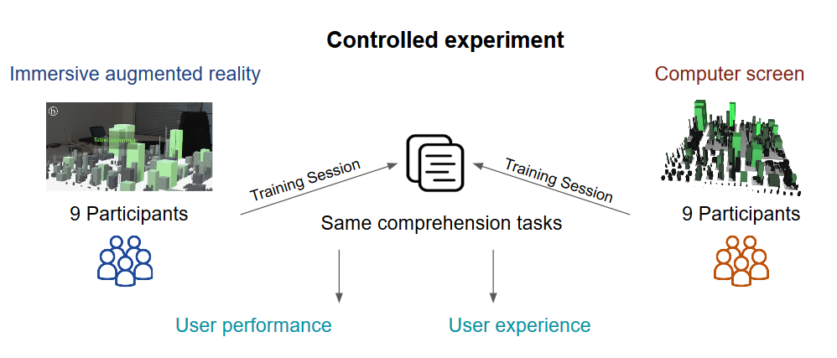
Good Parts
Construct Validity
Same building settings

Slide 18
Good Parts
Construct Validity
Same building settings
Internal Validity
Same building settings
Similar groups
Similar experiment rooms
Identical procedure

Slide 19
Good Parts
Construct Validity
Same building settings
Internal Validity
Same building settings
Similar groups
Similar experiment rooms
Identical procedure
External Validity
Training sessions
Between-groups design:
No learning effects

Slide 20

Limitations
Construct Validity
Visualization quality
Recollection measure

Slide 21
Limitations
Construct Validity
Visualization quality
Recollection measure
Internal Validity
Different method of instruction

Slide 22
Limitations
Construct Validity
Visualization quality
Recollection measure
Internal Validity
Different method of instruction
External Validity
Small sample
Only one data set
Selection bias: Students
Participant characteristics

Slide 23
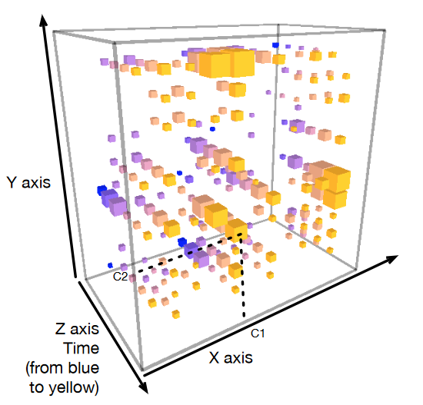
Types of Visualizations
3D City Visualizations
Space-Time Cube Visualizations
Richard Wettel (2017)
Teseo Schneider et al. (2016)
Notes:
Interaction between classes during an execution of a program
x and y axis represent the classes
Each cube in the system indicates the interaction between two specific classes
Example
z axis represents the time, colors from blue yellow
Size of a cube tells us the amount of interaction between two classes at a particular time frame

Slide 24
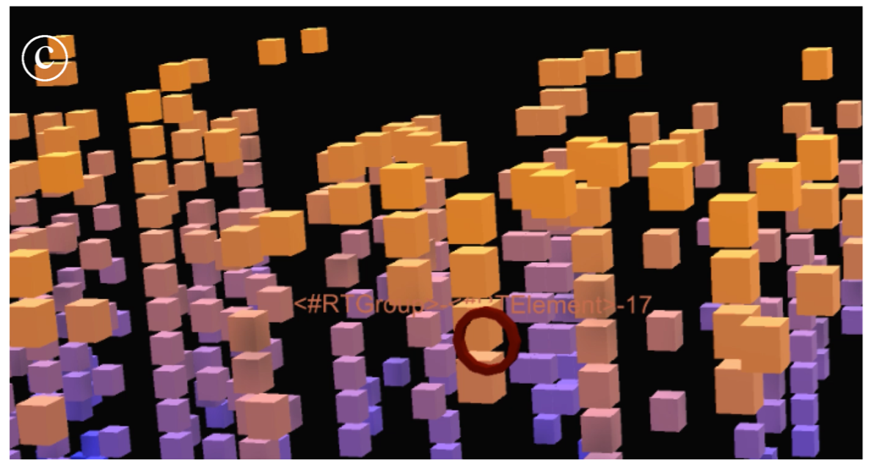


How did they proceed? Overcome Usability Issues of 3D Visualizations?
User Study
3D City Visualization
Space-Time Cube Visualization
Same 9 Participants
Comprehension tasks
Comprehension tasks
Reported Experiences
Notes:
Same participants of the controlled experiment who did immersive augmented reality condition
Comprehension tasks using the space time cube visualization
Conducted an interview & freely speak about their experiences

Slide 25
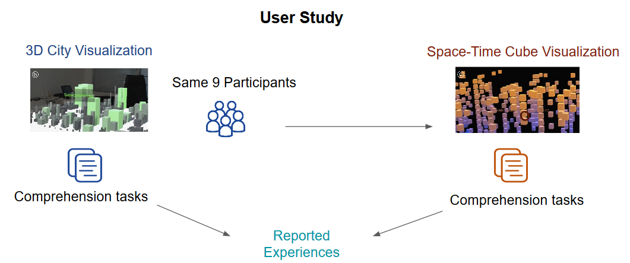
Good Parts
Same participants → Comparison of different techniques
Qualitative study → More detailed impressions collected
Different tasks → Reduced learning effect

Slide 26
Limitations
Unclear period of time between controlled experiment and user study
Usability issues not completely covered
Same data set → Learning effect
Selection bias: Students
Participant characteristics

Slide 27
Findings
RQ.1 Does Immersive Augmented Reality Help Overcoming 3D Usability Issues?
RQ.2 Does the Usage of Immersive Augmented Reality Increase Developers Effectiveness ?
RQ.1.1 Navigation
RQ.1.2 Selection
RQ.1.3 Occlusion
RQ.1.4 Text Readability

Slide 28
RQ.1 Usability Issues with 3D visualizations
Immersive Augmented Reality helps to overcome:
But these aspects still remain an issue:
RQ.1.1 Navigation
RQ.1.2 Occlusion
RQ.1.3 Selection
RQ.1.4 Text Readability
Notes:
displaying the space-time cube visualization in immersive augmented reality facilitates navigation and alleviates occlusion, while selection and text readability remain open issues
navigation:
It’s Easier to navigate while moving around than to use keyboard and mouse.
occlusion:
occluded elements can be revealed by changing the position of the viewer. However, navigation of 3D visualizations displayed on the standard computer screen is difficult, and thus, dealing with occlusion is hard. In contrast, since navigation of 3D visualizations in immersive augmented reality poses fewer difficulties, occlusion is not as relevant.
selection:
Participants often had trouble to stabilize the pointer on small buildings for enough time to read the labels. The difficulties that users experience to select elements in 3D visualizations impact their effectiveness, and better selection mechanism can improve user performance and experience. IAR: natural approach (e.g., head movement, hand gestures, voice recognition) → Remains still an issue
Text Readability:
Still an issue. Various aspects affect text readability, not only the fact of displaying text in 3D. For instance, a high contrast between the color of the text and its canvas can ease reading. we noticed that text that is not fixed in the visualization (e.g., anchored instead to the body of users) can be the source of difficulties

Slide 29
RQ.2 Effectiveness of 3D software Visualizations
3D visualizations in immersive augmented reality support developers in software comprehension tasks
They increase pattern detection
Notes:
significant differences in user performance and user experience when using the 3D software city visualization to deal with various software comprehension tasks. We observe that 3D visualizations are effective to support developers in software comprehension tasks.
We found that 3D city visualizations displayed in immersive augmented reality promote the detection of visual patterns that developers can relate to the characteristics of software systems.

Slide 30
RQ.2 Effectiveness of 3D software Visualizations
Time
Correctness
Difficulty
Recollection
Emotions
Notes:
→ Repeat hypothesis
Two tasks: Finding outliers and patterns
Developers who visualize software cities for comprehension displayed on a standard computer screen require the least time to find outliers.

Slide 31
RQ.2 Effectiveness of 3D software Visualizations
Time
Correctness
Difficulty
Recollection
Emotions
Notes:
→ Repeat hypothesis
Two tasks: Finding outliers and patterns
Developers who visualize software cities for comprehension displayed on a standard computer screen achieve the highest correctness to find outliers.
→ Surely, fine-tuning the design of the immersive augmented reality deployment can improve completion time and correctness of tasks. For instance, the choice of the size of the city can impact the amount of navigation required to find elements

Slide 32
RQ.2 Effectiveness of 3D software Visualizations
Time
Correctness
Difficulty
Recollection
Emotions
Notes:
→ Repeat hypothesis
Two tasks: Finding outliers and patterns
Developers who visualize software cities for comprehension displayed in immersive augmented reality perceive the least difficulty to find outliers.
But identify patterns was less difficult on screen

Slide 33
RQ.2 Effectiveness of 3D software Visualizations
Time
Correctness
Difficulty
Recollection
Emotions
Notes:
→ Repeat hypothesis
Two tasks: Finding outliers and patterns
Recollection:
We ask participants to draw their recollection of the visualization of the Azureus city using an application in a tablet.
Measured ink participants used → more ink, more detail they remembered
→ more design problems found in immersive augmented reality
We observed that participants who used immersive augmented reality were able to recollect many details of the system.

Slide 34
RQ.2 Effectiveness of 3D software Visualizations
Time
Correctness
Difficulty
Recollection
Emotions
Notes:
→ Repeat hypothesis
Two tasks: Finding outliers and patterns
Emotions:
Mostly Positive emotions among participants.
“curiouser” and “challenging” → good level of engagement
But: “fatigue” and “pained” → sessions demanded too much effort form the participants

Slide 35
RQ.2 Effectiveness of 3D software Visualizations
Time
Correctness
Difficulty
Recollection
Emotions
Notes:
→ Repeat hypothesis
Two tasks: Finding outliers and patterns
Developers who visualize software cities for comprehension displayed on a standard computer screen require the least time to find outliers.
Developers who visualize software cities for comprehension displayed on a standard computer screen achieve the highest correctness to find outliers.
→ Surely, fine-tuning the design of the immersive augmented reality deployment can improve completion time and correctness of tasks. For instance, the choice of the size of the city can impact the amount of navigation required to find elements
Developers who visualize software cities for comprehension displayed in immersive augmented reality perceive the least difficulty to find outliers.
But identify patterns was less difficult on screen
Recollection:
We ask participants to draw their recollection of the visualization of the Azureus city using an application in a tablet.
Measured ink participants used → more ink, more detail they remembered
→ more design problems found in immersive augmented reality
We observed that participants who used immersive augmented reality were able to recollect many details of the system.
Emotions:
Positive emotions among participants.
“curiouser” and “challenging” → good level of engagement
But: “fatigue” and “pained” → sessions demanded too much effort form the participants

Slide 36
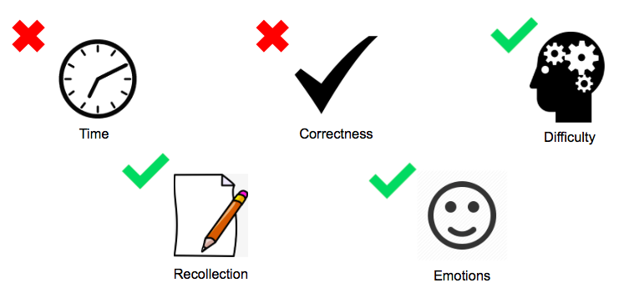
Summary
RQ.1.1 Navigation
RQ.1.2 Occlusion
RQ.1.3 Selection
RQ.1.4 Text Readability

Slide 37
Discussion
What are the two most surprising findings?
Find two ways in which the study can be improved?
Name two possible future researches?
Notes:
What are the two most suprising findings
Find two ways in which the study can be improved

Slide 38
Discussion
What are the two most surprising findings?
Find two ways in which the study can be improved?
Name two possible future researches?
Notes:
What are the two most suprising findings
Find two ways in which the study can be improved

Slide 39
Discussion
What are the two most surprising findings?
Find two ways in which the study can be improved?
Name two possible future researches?
Notes:
What are the two most suprising findings
Find two ways in which the study can be improved

Slide 40
Discussion
What are the two most surprising findings?
Find two ways in which the study can be improved?
Name two possible future researches?
Notes:
What are the two most suprising findings
Find two ways in which the study can be improved

Slide 41
Literature
Barritt, J. (2015). Walk the streets of your codebase: inFusion, Code City and a MOOSE). http://jimbarritt.com/non-random/2010/10/25/walk-the-streets-of-your-codebase-infusion-code-city-and-a-moose/. Last visited: 22.10.2018
Merino, L., Bergel, A., & Nierstrasz, O. (2018). Overcoming issues of 3D software visualization through immersive augmented reality. Proc. of VISSOFT, page in review. IEEE.
Teseo Schneider, et. al. (2016).CuboidMatrix: Exploring Dynamic Structural Connections in Software Components Using Space-Time Cube. IEEE.
Wettel, R. (2017). Welcome to CodeCity!. https://wettel.github.io/codecity.html. Last visited: 22.10.2018

